Slide 1

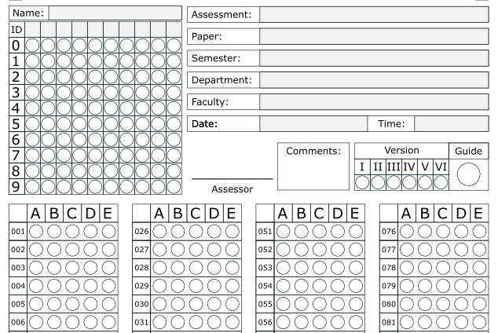




Instructions for using Answer Sheets
1
How to mark?
Write your name and ID, and mark the circles for each digit of your ID.
2
Use BLACK or BLUE ballpen.
Fill these boxes if they are not already filled.
Fill the circles like this one.
Don’t use PENCIL!
3
Mark the answers.
Don’t fill like these:
Copyright © oMarking.net

